Slide 1
NCES Private School Data from
Repeating Studies
Council for American Private Education Meeting
March 10, 2024
Chris Chapman
National Center for Education Statistics
William Ward
National Center for Education Statistics

Slide 2







Overview
Repeating Study Findings on Private Schools and Their Staff
Study Updates
The Early Childhood Longitudinal Study, Kindergarten Class of 2023-24
High School and Beyond 2022 (HS&B:22): Progress of the Newest Study
NAEP 2024 Overview
National Board for Education Sciences (NBES)
NCES Participation in International Assessments

Slide 3

National Center for Education Statistics (NCES)
NCES is within the U.S. Department of Education.
NCES is one of 13 principal federal statistical agencies and has been responsible for producing official federal education statistics in varying capacities since 1867.
As a principal federal statistical agency, NCES must provide the public with objective, reliable, and trustworthy information.
Central to these responsibilities are properly designed data collection and reporting systems that limit response burden.
National Center for Education Statistics (NCES)

Slide 4
Repeating Studies of Private Schools and Their Staff
National Center for Education Statistics (NCES)
4

Slide 5
Private School Universe Survey (PSS)
Biennial collection of data on the characteristics of all K-12 private schools across the United States (50 States and the District of Columbia).
Conducted since 1989
Provides basic directory information and school characteristics
Used to generate NCES ID number
Private school locator on the NCES website and a source for many other websites and services
National Center for Education Statistics (NCES)
SOURCE: 2021–22 Private School Survey

Slide 6
National Teacher and Principal Survey (NTPS)
Conducted every three years with a sample of public and private schools
Respondents are school staff including principals and a sample of teachers within the school
Primary source of national and state data on K-12 schools from the perspectives of public and private school staff
Designed for trend analyses 1987-88 to 2020-21
Backbone of many key indicators in NCES’s mandated annual Condition of Education report to Congress
National Center for Education Statistics (NCES)

Slide 7



2021–22 Teacher Follow-up Survey (TFS)
Recontacted teachers 1 year later
National Teacher and Principal Survey (NTPS)
2021–22 Principal Follow-up Survey (PFS)
Recontacted principals 1 year later
2020–21 NTPS
Schools, principals, teachers
National Center for Education Statistics (NCES)

Slide 8
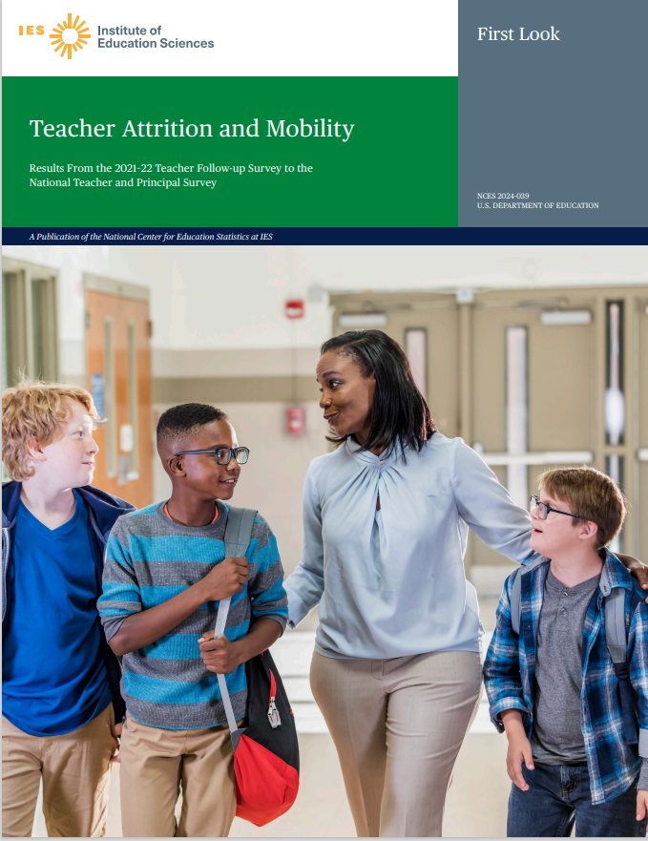
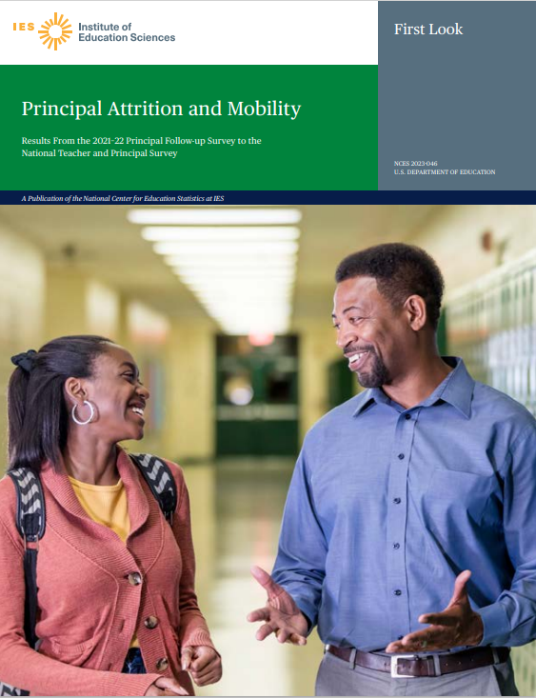
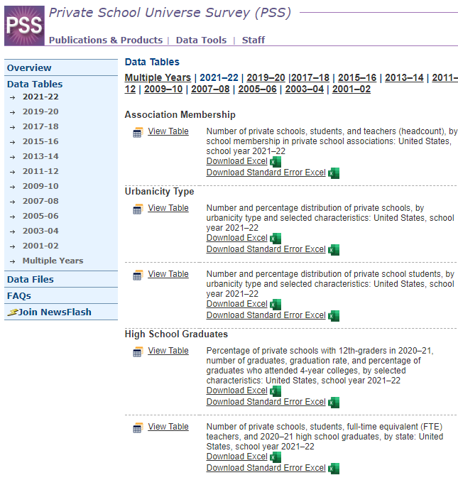
Recent Reports
Teacher Attrition and Mobility: Results From the 2021–22 Teacher Follow-up Survey to the National Teacher and Principal Survey (ed.gov)
Principal Attrition and Mobility: Results From the 2021–22 Principal Follow-up Survey to the National Teacher and Principal Survey
National Center for Education Statistics (NCES)

Slide 9
Contacts for Private School Survey, National Teacher and Principal Survey, and the Teacher and Principal Follow-up Surveys
Private School Survey – Marie Diederich and Andy Zukerberg
  marie.diederich@ed.gov
  andrew.zukerberg@ed.gov
National Teacher and Principal Survey – Maura Spiegelman and Andy Zukerberg
  maura.spiegelman@ed.gov
  andrew.zukerberg@ed.gov
Teacher and Principal Follow-up Survey – Julia Merlin and Andy Zukerberg
  julia.merlin@ed.gov
  andrew.zukerberg@ed.gov
National Center for Education Statistics (NCES)

Slide 10
Findings: Characteristics of Private Schools in 2021-22
National Center for Education Statistics (NCES)
10

Slide 11
Overview of Private Schools in the 2021-22 School Year
In the 2021-22 school year, 29,700 private schools:
  Enrolled 4.7 million K-12 students;
  and employed 483,000 full-time-equivalent teachers
Sixty-six percent of private schools reported having a religious orientation.
Roughly 20,000 schools reported membership in at least one private school association.
Sixty-eight percent of private schools emphasized regular elementary or secondary programs.
National Center for Education Statistics (NCES)
SOURCE: 2021–22 Private School Survey

Slide 12

Number of Private Schools Decreased 3% from 2019–20 to 2021–22
Elementary/Middle
The ﻿number of schools
decreased by 6%.
Catholic
The number of schools
decreased by 5%.
National Center for Education Statistics (NCES)
SOURCE: Private School Universe Survey (PSS), 2019-20 and 2021-22

Slide 13
Enrollment in Private Schools by School Level: SY 2019–20 to SY 2021–22
Combined/Other
Elementary/Middle
Secondary/High
Enrollment
decreased by 2%.
Enrollment
decreased by 5%.
Enrollment
increased by 9%.
NOTE: Combined/other schools are schools that comprise one or more of grades K–6 and one or more of grades 9–12 or schools that are ungraded.
National Center for Education Statistics (NCES)
SOURCE: Private School Universe Survey (PSS), 2019-20 and 2021-22

Slide 14

Number of Full-Time-Equivalent Teachers at Private Schools: SY 2﻿019–20 to SY 2021–22
Elementary/middle
The ﻿number of teachers
decreased by 3%.
Combined/other
The number of teachers
increased by 5%.
NOTE: Combined/other schools are schools that comprise one or more of grades K–6 and one or more of grades 9–12 or schools that are ungraded.
National Center for Education Statistics (NCES)
SOURCE: Private School Universe Survey (PSS), 2019-20 and 2021-22

Slide 15

Number of Full-Time-Equivalent Teachers at Private Schools: SY 2﻿019–20 to SY 2021–22
Catholic schools
The number of teachers
decreased by 4%.
Other Religious Schools
The number of teachers increased by 4%.
NOTE: Other religious schools are Conservative Christian, other affiliated, and unaffiliated religious schools.
National Center for Education Statistics (NCES)
SOURCE: Private School Universe Survey (PSS), 2019-20 and 2021-22

Slide 16
Findings: Principal and Teacher Workforce Characteristics
National Center for Education Statistics (NCES)

Slide 17

Characteristics of the 2020–21 Principal Workforce
Race/ethnicity
83%* non-Hisp. White
Sex
63%* female
Average age
Salary
51* years old
$78,600*
Private
6%* non-Hisp. Black
6%* Hisp.
2%* non-Hisp. Asian
1% non-Hisp. two or more races
77% non-Hisp. White
56% female
49 years old
$105,900
Public
1% non-Hisp. two or more races
10% non-Hisp. Black
9% Hisp.
1% non-Hisp. Asian
!!
National Center for Education Statistics (NCES)
SOURCE: 2020–21 National Teacher and Principal Survey
* Statistically significantly different (p < .05) from public

Slide 18
Characteristics of the 2020–21 Teacher Workforce
Race/ethnicity
83%* non-Hisp. White
Sex
75% female
Average age
Salary
45* years old
$46,400* (base, full-time)
Private
8%* Hisp.
4%* non-Hisp. Black
2% non-Hisp. Asian
2% non-Hisp. two or more races
80% non-Hisp. White
77% female
43 years old
$61,600 (base, full-time)
Public
9% Hisp.
6% non-Hisp. Black
2% non-Hisp. Asian
2% non-Hisp. two or more races
!!
National Center for Education Statistics (NCES)
SOURCE: 2020–21 National Teacher and Principal Survey
* Statistically significantly different (p < .05) from public

Slide 19
Findings: Principal and Teacher Working Conditions
National Center for Education Statistics (NCES)

Slide 20
Principals’ Typical Week
Percentage of time spent on various school-related tasks
54.5
(private)
Total hours worked
58.3*
(public)
* Statistically significantly different (p < .05) from public
National Center for Education Statistics (NCES)
SOURCE: 2020–21 National Teacher and Principal Survey

Slide 21
Principals Reporting Having Major Influence Over Decisions About:
Private |  | Public
83.2% | Evaluating teachers | 92.9%*
85.8% | Hiring new full-time teachers | 89.4%*
77.9% | Determining the content of in-service professional development programs | 63.6%*
77.0% | Setting discipline policy | 60.2%*
71.5% | Setting performance standards for students at their school | 58.7%*
58.9% | Deciding how the school budget will be spent | 57.6%
65.3% | Establishing curriculum | 35.0%*
NOTE: response options included “no influence,” “minor influence,” “moderate influence,” “major influence,” and “not applicable.” Data for principals who reported “not applicable” are excluded from the estimates.
* Statistically significantly different (p < .05) from private
National Center for Education Statistics (NCES)
SOURCE: 2020–21 National Teacher and Principal Survey

Slide 22
Full-Time Teachers Spent 52 Hours Working During a Typical Week
NOTE: refers to a regular full-time teacher, whose primary position in a school is not an itinerant teacher, a long-term substitute, a short-term substitute, a student teacher, a teacher aide, an administrator, a library media specialist or librarian, another type of professional staff (e.g., counselor, curriculum coordinator, social worker) or support staff (e.g., secretary), or part-time teacher.
!!
National Center for Education Statistics (NCES)
SOURCE: 2020–21 National Teacher and Principal Survey
* Statistically significantly different (p < .05) from public

Slide 23
Teachers’ Income
Percentage of regular, full-time teachers with various types of salary supplements
$46,400*
(private)
Base salary for regular, full-time teachers
$61,600
(public)
NOTE: refers to a regular full-time teacher, whose primary position in a school is not an itinerant teacher, a long-term substitute, a short-term substitute, a student teacher, a teacher aide, an administrator, a library media specialist or librarian, another type of professional staff (e.g., counselor, curriculum coordinator, social worker) or support staff (e.g., secretary), or part-time teacher.
National Center for Education Statistics (NCES)
SOURCE: 2020–21 National Teacher and Principal Survey
* Statistically significantly different (p < .05) from public

Slide 24
Teachers Reporting Having Any Control in Their Classroom Over:
Private |  | Public
99.1% | Evaluating and grading students | 98.1%*
99.4% | Selecting teaching techniques | 97.7%*
98.1% | Determining the amount of homework to be assigned | 96.7%*
98.3% | Disciplining students | 96.0%*
96.5% | Selecting content, topics, and skills to be taught | 86.2%*
95.1% | Selecting textbooks and other instructional materials | 84.1%*
NOTE: response options included “no control,” “minor control,” “moderate control,” and “a great deal of control.” Teachers who reported “minor control,” “moderate control,” or “a great deal of control” were considered to have reported having “any control.”
National Center for Education Statistics (NCES)
SOURCE: 2020–21 National Teacher and Principal Survey
* Statistically significantly different (p < .05) from private

Slide 25
Teachers Reporting Having Any Influence Over School Policies About:
Private |  | Public
95.6% | Establishing curriculum | 84.9%*
93.1% | Setting performance standards for students at their school | 81.5%*
84.0% | Determining the content of in-service professional development programs | 80.8%*
82.1% | Setting discipline policy | 71.0%*
61.8% | Hiring new full-time teachers | 62.7%
47.8% | Deciding how the school budget will be spent | 53.6%*
63.5% | Evaluating teachers | 50.5%*
NOTE: response options included “no influence,” “minor influence,” “moderate influence,” and “a great deal of influence.” Teachers who reported “minor influence,” “moderate influence,” or “a great deal of influence” were considered to have reported having “any influence.”
National Center for Education Statistics (NCES)
SOURCE: 2020–21 National Teacher and Principal Survey
* Statistically significantly different (p < .05) from private

Slide 26
Findings: School Operations
National Center for Education Statistics (NCES)

Slide 27
Both Public and Private Schools with Vacancies in Various Subject Areas: Some Found it Very Difficult or Were Unable to Fill Their Vacancies
NOTE: among schools with a vacancy in a given subject area, the percentage that found it very difficult or were unable to fill a vacancy.
National Center for Education Statistics (NCES)
SOURCE: 2020–21 National Teacher and Principal Survey
* Statistically significantly different (p < .05) from public

Slide 28
Both Public and Private Schools with Vacancies in Various Subject Areas: Some Found it Very Difficult or Were Unable to Fill Their Vacancies (Continued)
NOTE: Among schools with a vacancy in a given subject area, the percentage that found it very difficult or were unable to fill a vacancy.
National Center for Education Statistics (NCES)
SOURCE: 2020–21 National Teacher and Principal Survey
* Statistically significantly different (p < .05) from public

Slide 29
Findings: Principal Attrition
National Center for Education Statistics (NCES)

Slide 30
One Year Later, Were K-12 Public and Private School Principals and Teachers:
Stayers
Worked as a principal/teacher in the same school during the 2020-21 and 2021-22 school years
Movers
Moved to another school but remained a principal/teacher during the 2021–22 school year
Leavers
Left the profession; no longer working as a principal/teacher during the 2021–22 school year
National Center for Education Statistics (NCES)

Slide 31
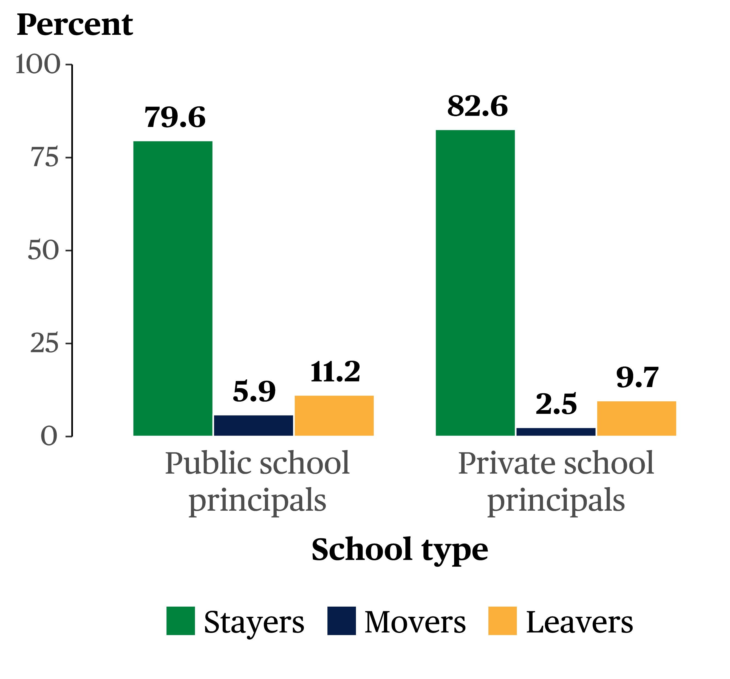
Between the 2020-21 and 2021-22 School Years…
11.2 percent of public and
9.7 percent of private school principals left the profession
5.9 percent of public and
2.5 percent of private school principals moved to a different school
*
*
National Center for Education Statistics (NCES)
SOURCE: 2021-22 Principal Follow-up Survey
* Statistically significantly different (p < .05) from private

Slide 32
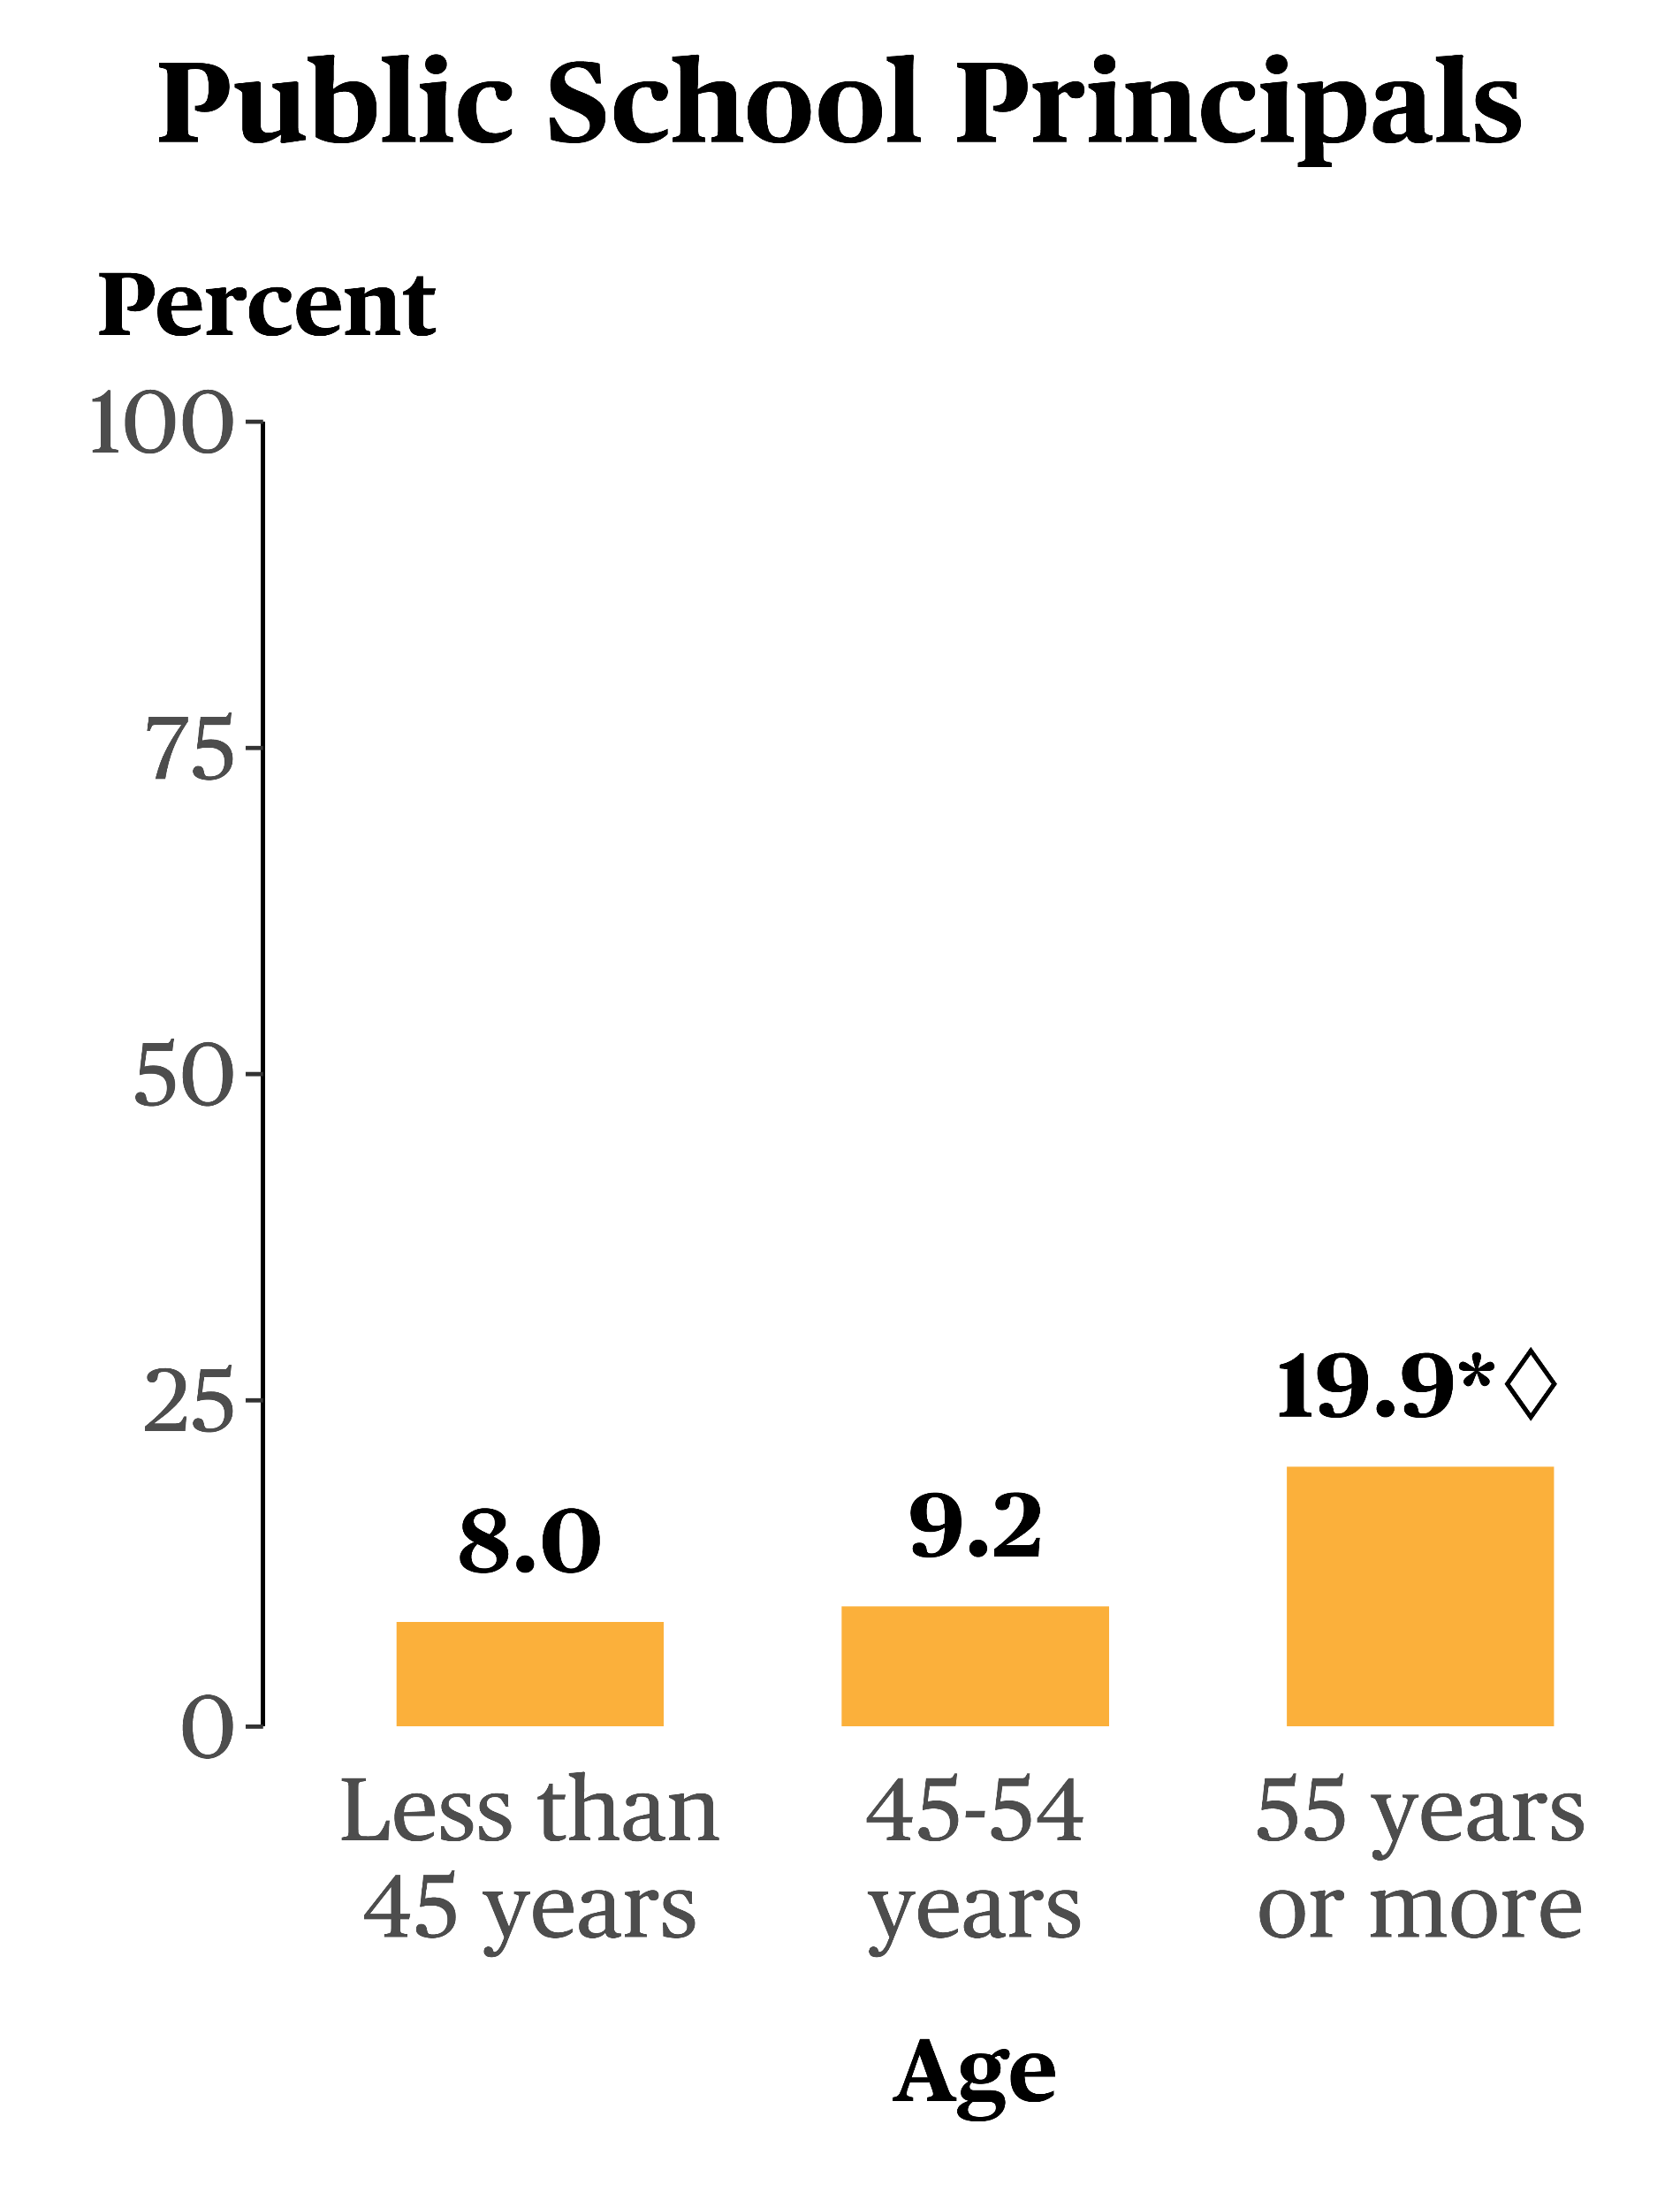
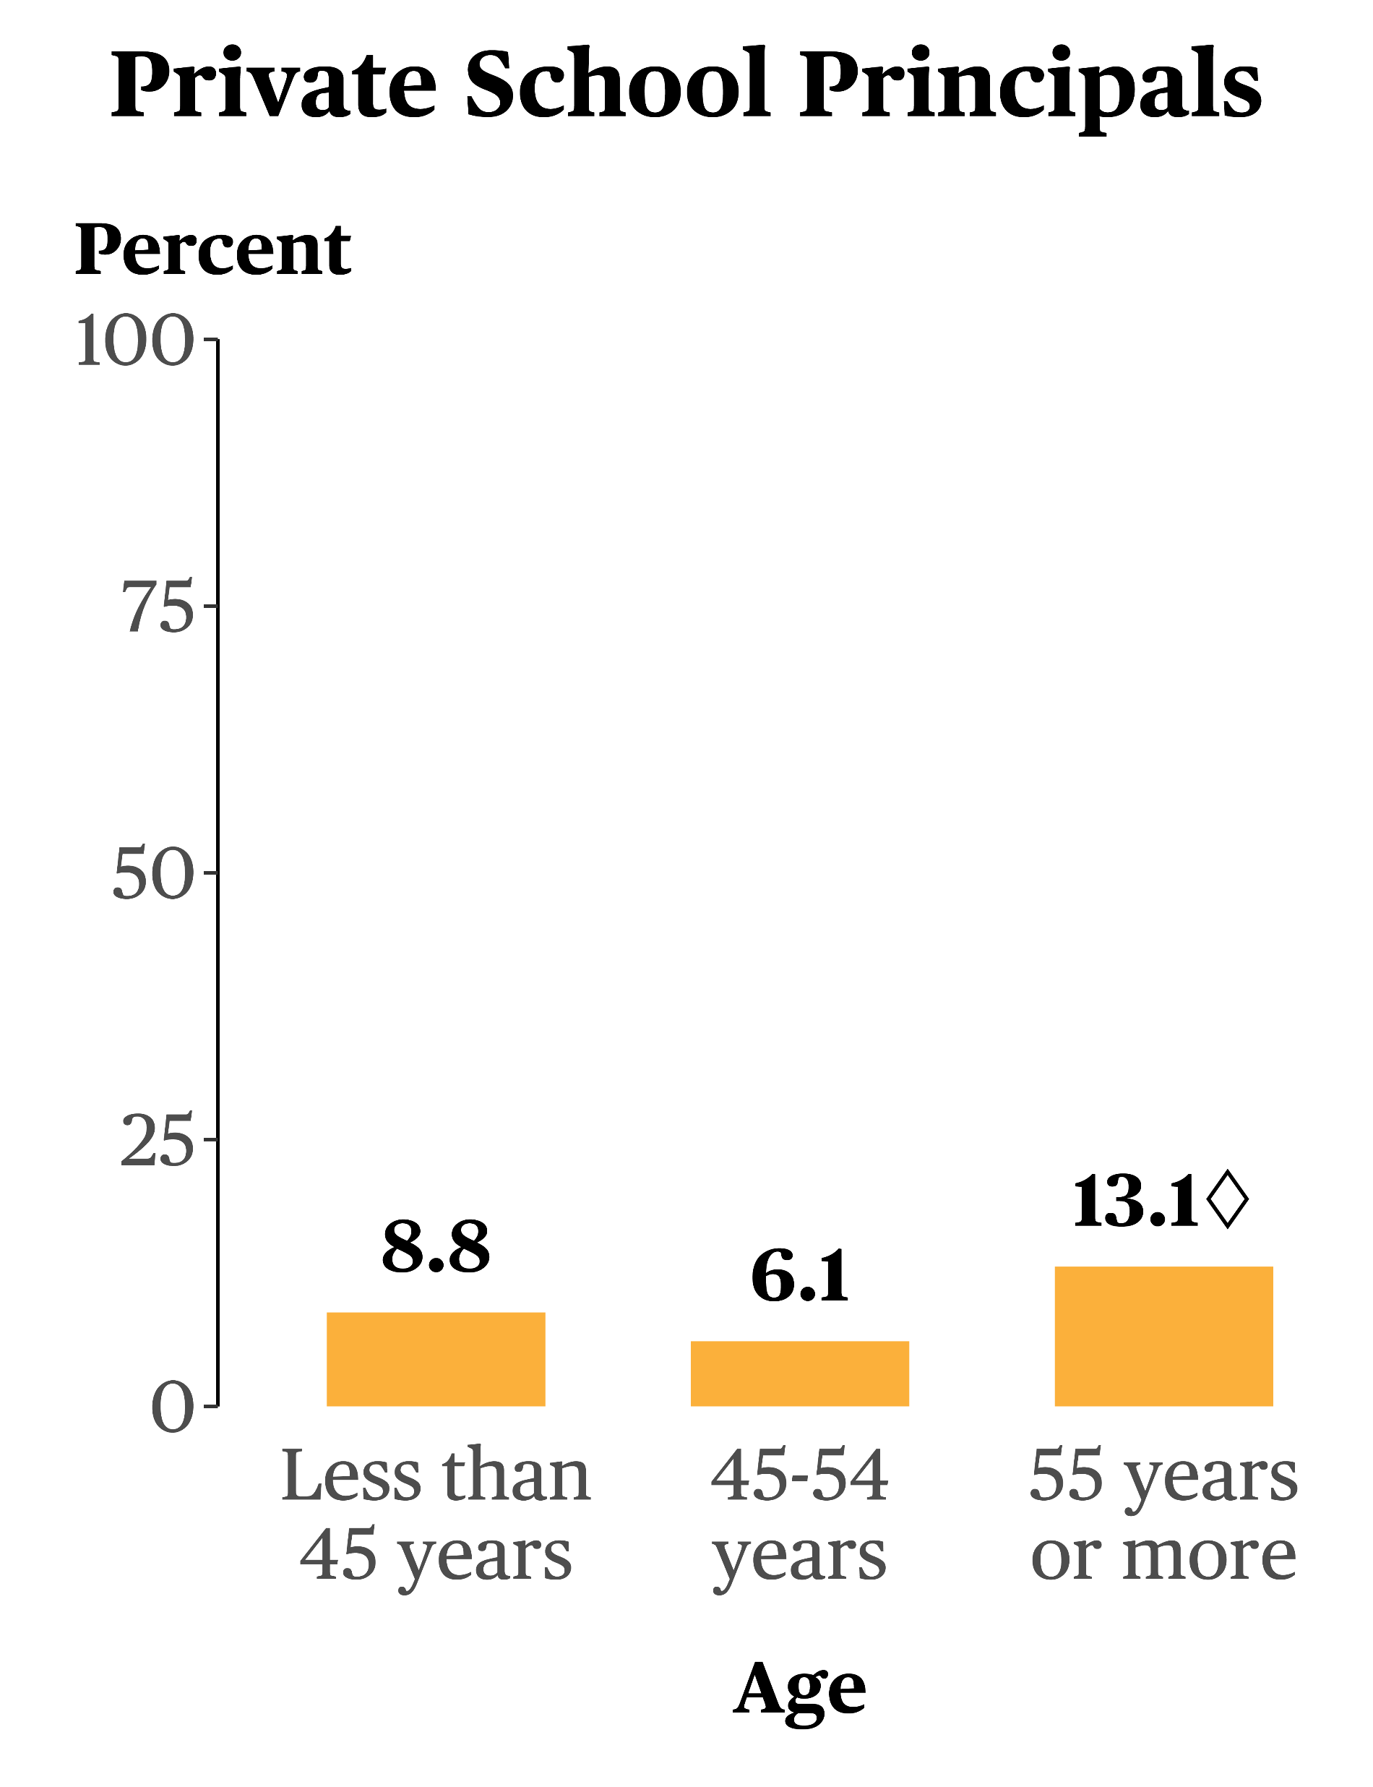
Principal Leavers by Age Between the 2020-21 and 2021-22 School Years
* Statistically significantly different (p < .05) from principals less than 45 years old
National Center for Education Statistics (NCES)
SOURCE: 2021-22 Principal Follow-up Survey
◊ Statistically significantly different (p < .05) from principals 45-54 years old

Slide 33
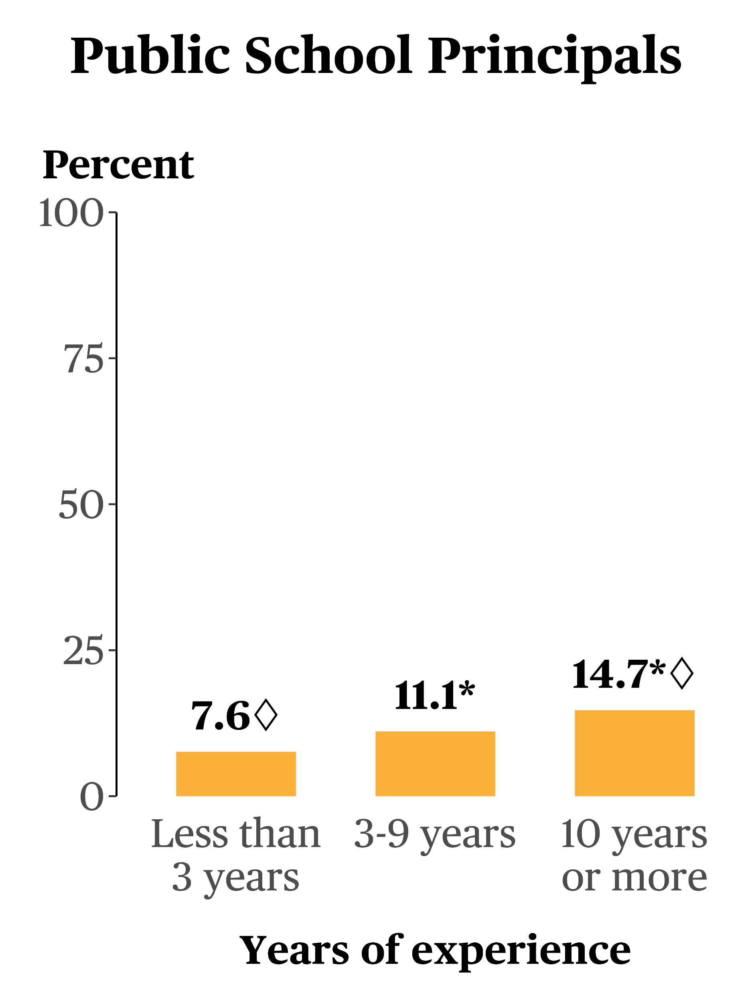
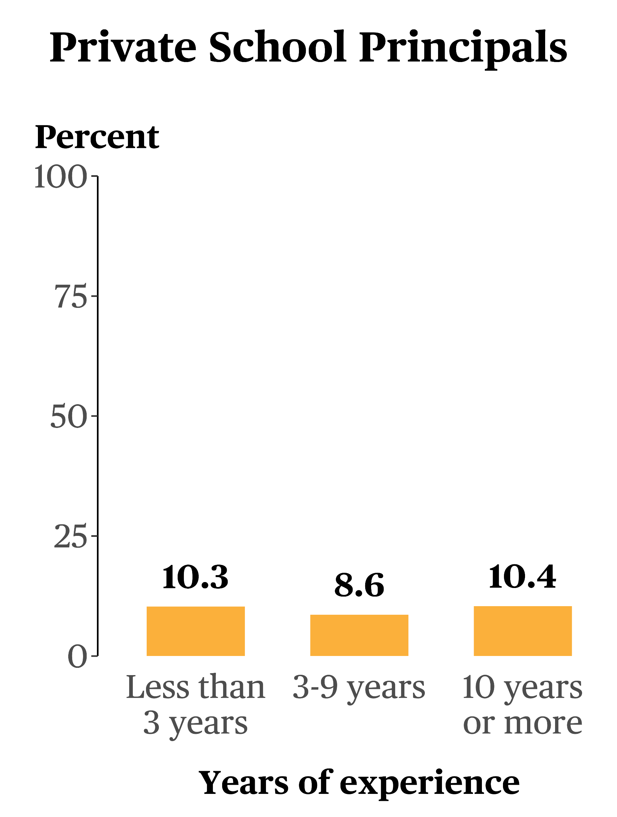
Principal Leavers by Years of Experience Between the 2020-21 and 2021-22 School Years
* Statistically significantly different (p < .05) from principals with less than 3 years of experience
National Center for Education Statistics (NCES)
SOURCE: 2021-22 Principal Follow-up Survey
◊ Statistically significantly different (p < .05) from principals with 3-9 years of experience

Slide 34
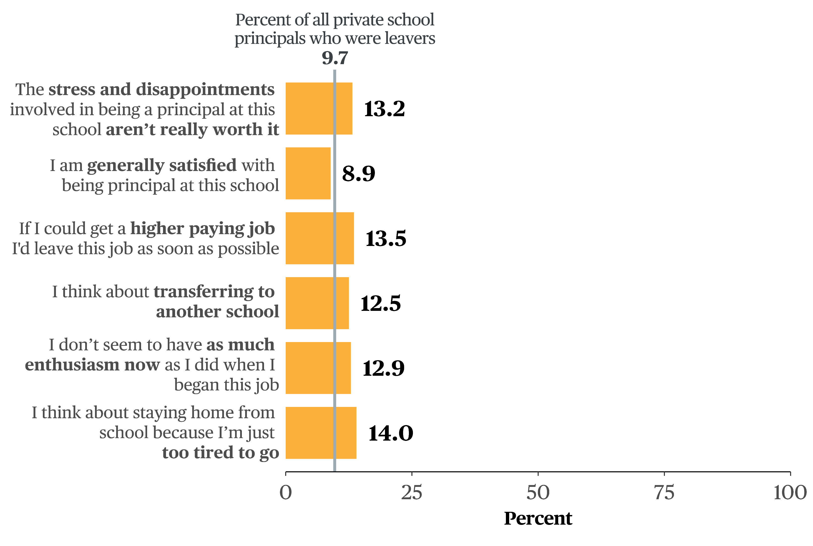
Did Satisfied Private School Principals Leave the Profession?
NOTE: Includes private school principals who “strongly” or “somewhat” agreed with the statement. Response options were “strongly disagree,” “somewhat disagree,” “somewhat agree,” strongly agree.”
National Center for Education Statistics (NCES)
SOURCE: 2021-22 Principal Follow-up Survey

Slide 35
Findings: Teacher Attrition
National Center for Education Statistics (NCES)

Slide 36
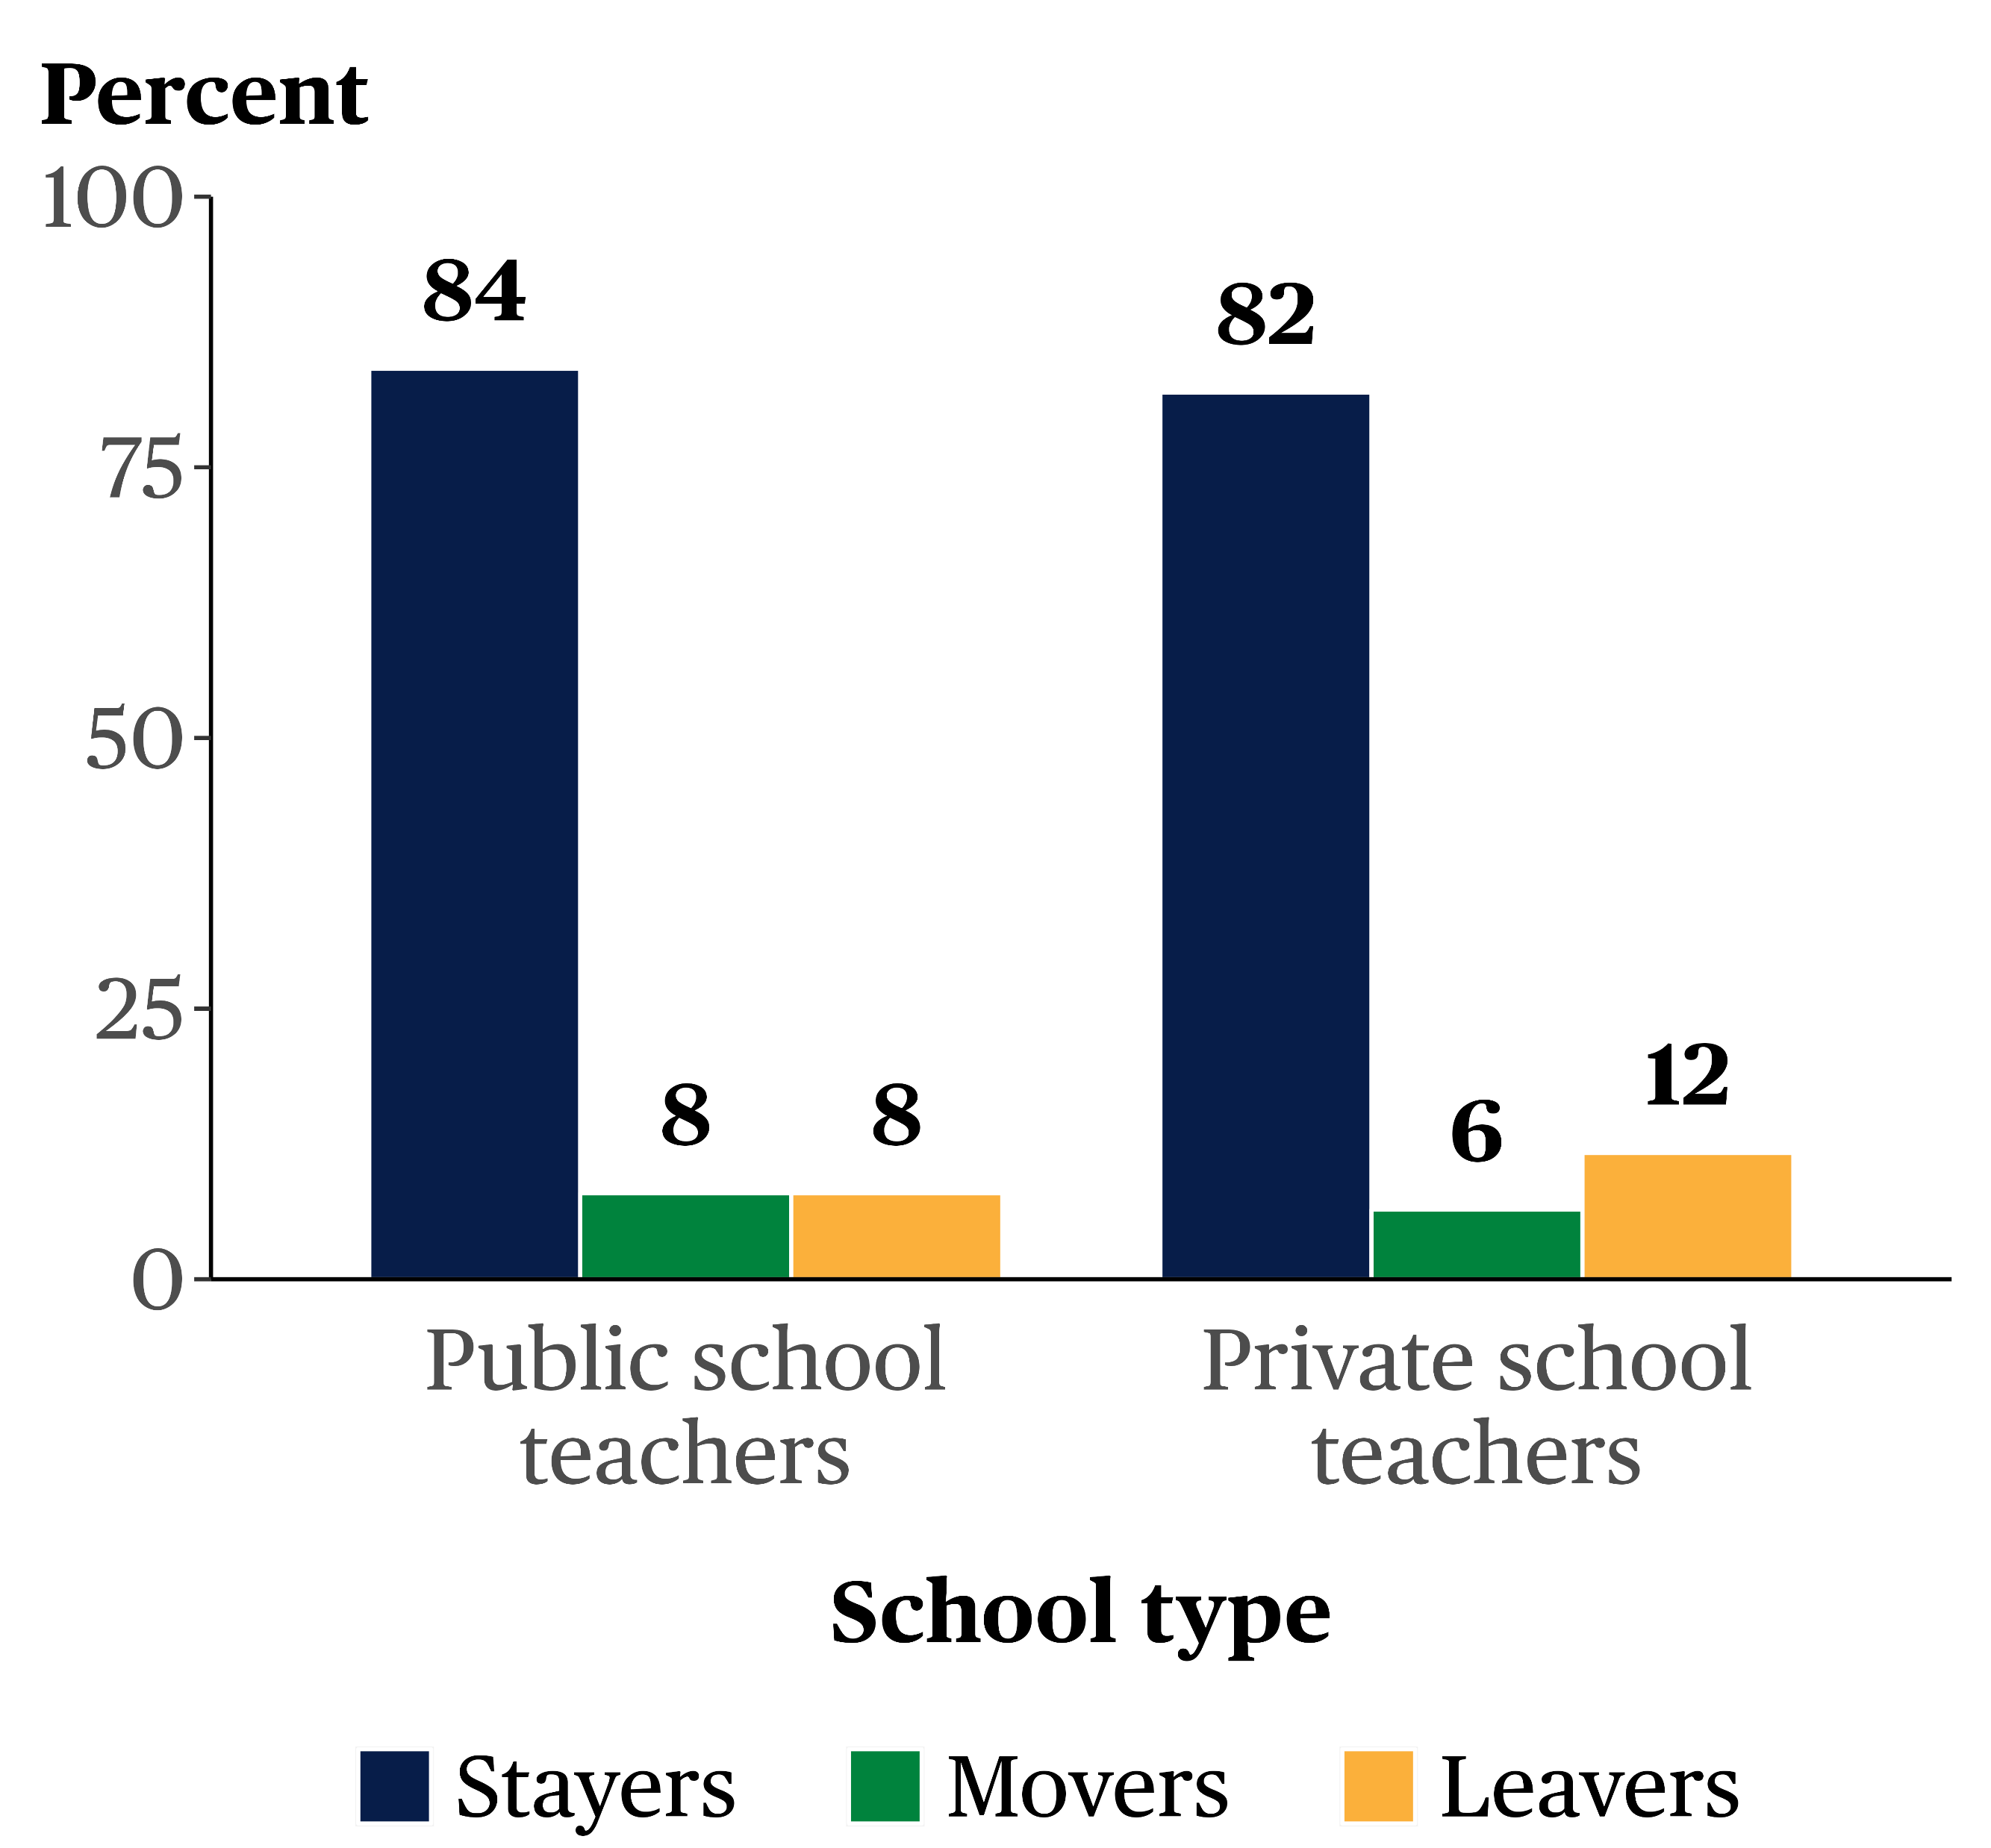
Change in Job Status Between the 2020-21 and 2021-22 School Years
7.9 percent of public and
11.7 percent of private school teachers left the profession; and
7.9 percent of public and
6.4 percent of private school teachers moved to a different school
*
*
National Center for Education Statistics (NCES)
SOURCE: 2021-22 Teacher Follow-up Survey
* Statistically significantly different (p < .05) from private school teachers

Slide 37
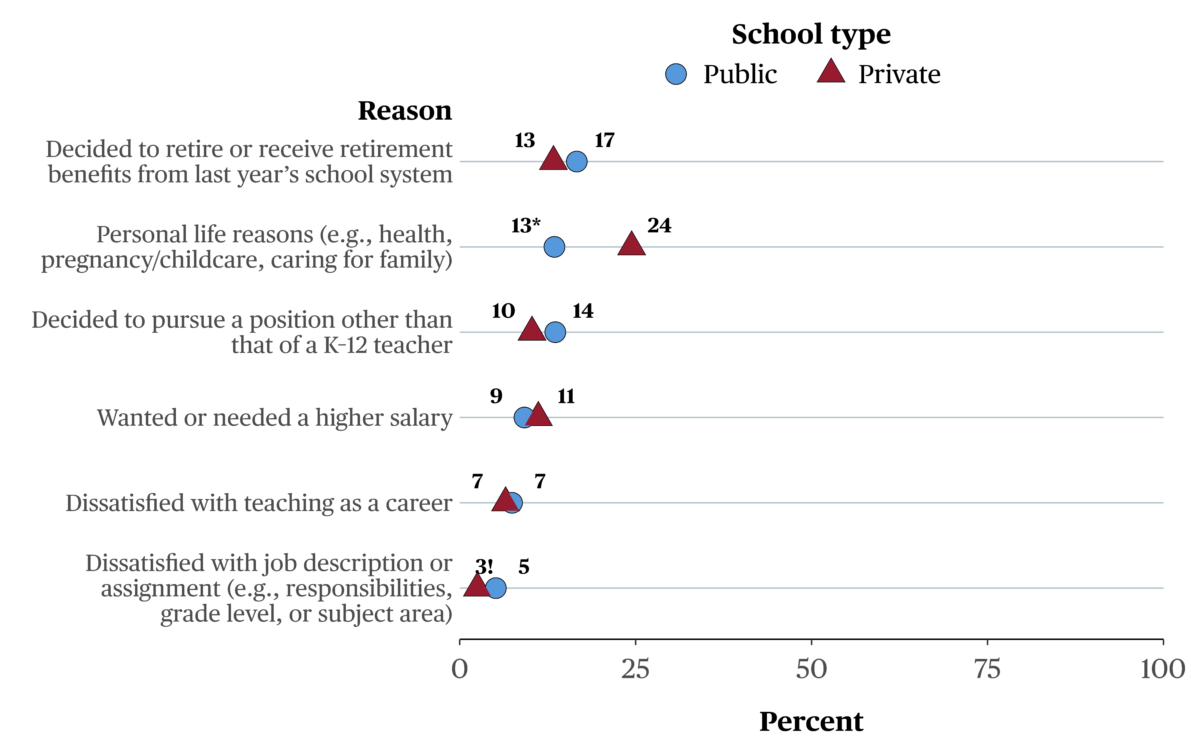
Teachers' Most Important Reasons for Leaving the Profession Between 2020-21 and 2021-22
! Interpret data with caution. The coefficient of variation (CV) for this estimate is 30 percent to 50 percent (i.e., the standard error is at least 30 percent and less than 50 percent of the estimate).
National Center for Education Statistics (NCES)
SOURCE: 2021–22 Teacher Follow-up Survey
* Statistically significantly different (p < .05) from private school teachers

Slide 38
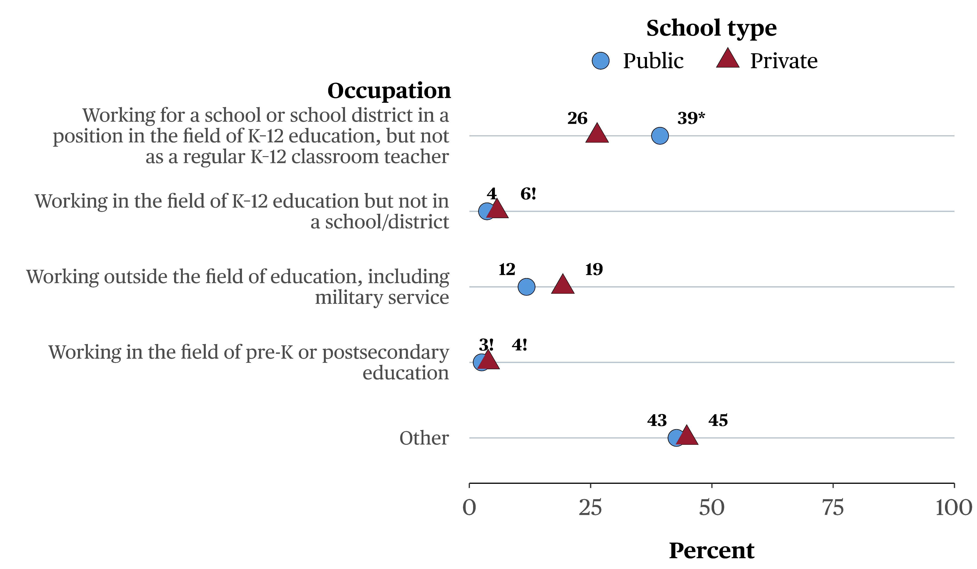
Former Teachers’ Occupations in 2021-22
! Interpret data with caution. The coefficient of variation (CV) for this estimate is 30 percent to 50 percent (i.e., the standard error is at least 30 percent and less than 50 percent of the estimate).
National Center for Education Statistics (NCES)
SOURCE: 2021–22 Teacher Follow-up Survey
* Statistically significantly different (p < .05) from private school teachers

Slide 39
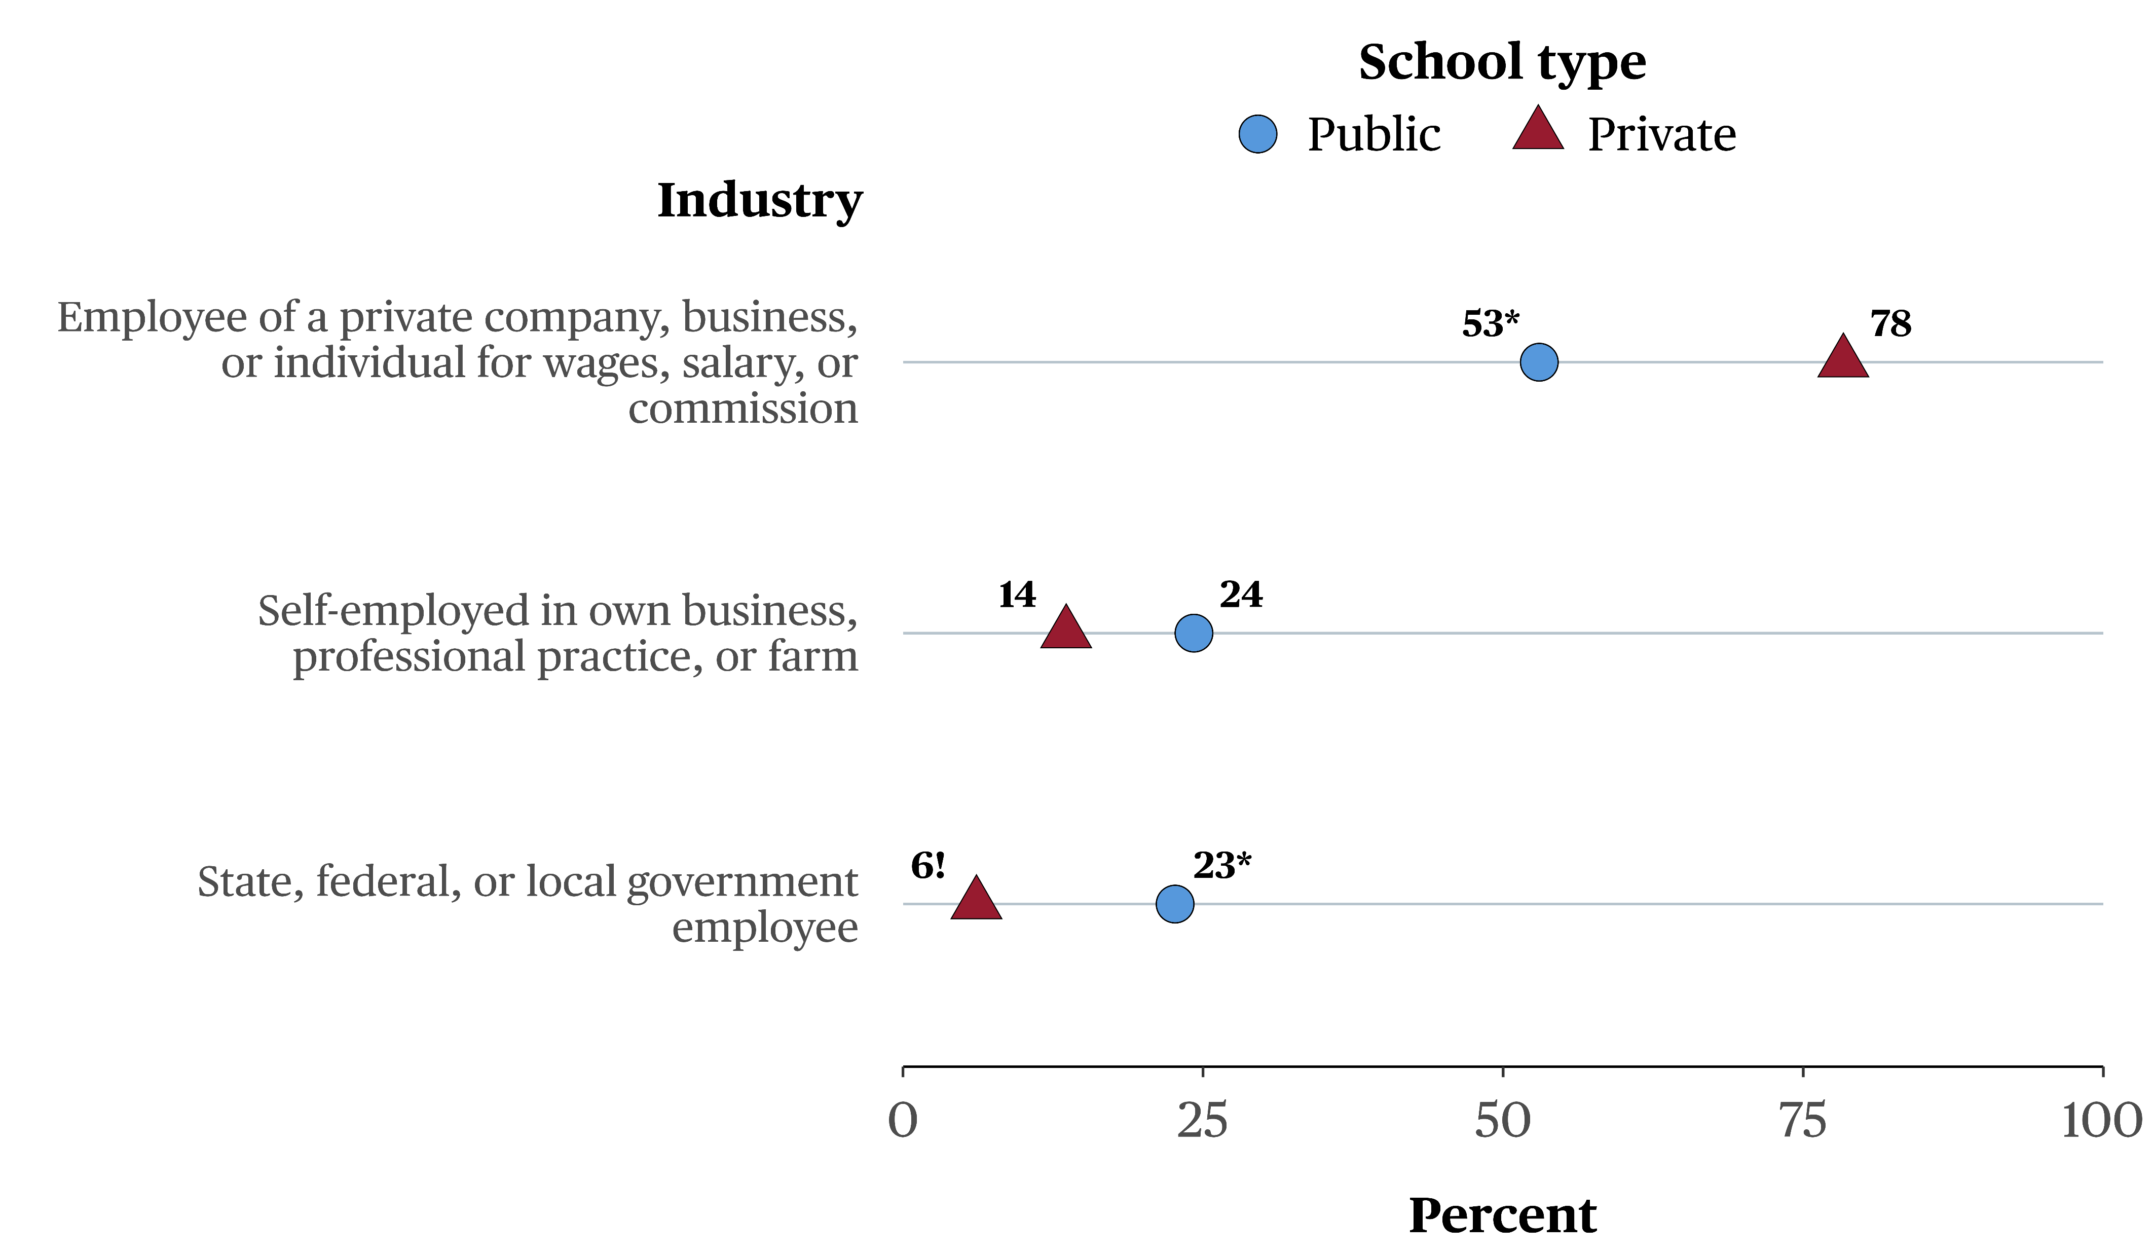
Kinds of Industry in Which Former Teachers Worked in 2021-22
! Interpret data with caution. The coefficient of variation (CV) for this estimate is between 30 percent and 50 percent (i.e., the standard error is at least 30 percent and less than 50 percent of the estimate).
NOTE: Estimates indicate the industry status of leavers whose main occupational status was working in a position in the field of pre-K or
postsecondary education, working in the field of K–12 education but not in a school/district, or working outside the field of education, including military service
National Center for Education Statistics (NCES)
SOURCE: 2021–22 Teacher Follow-up Survey
* Significantly different (p < .05) from private school teachers

Slide 40
Study Updates
National Center for Education Statistics (NCES)

Slide 41
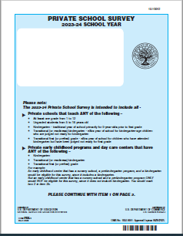
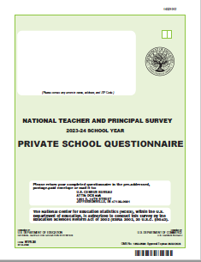
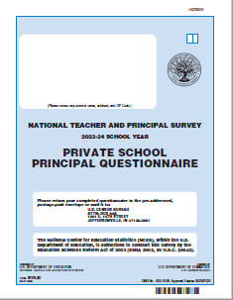
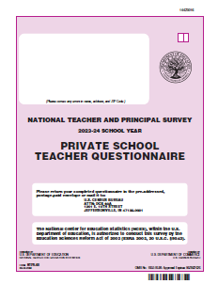
Study Updates: PSS and NTPS
Data collection began September 2023 and ends May 2024
  Private School Survey
  National Teacher and Principal Survey
National Center for Education Statistics (NCES)

Slide 42
Recent and Upcoming Releases
Upcoming Releases
NCES Fast Fact: Private School Survey | February 7, 2024
Report on the Condition of Education 2024 | May 2024
Past Releases
Teacher Attrition and Mobility. Results From the 2021-22 Teacher Follow- up Survey to the National Teacher and Principal Survey | December 13, 2023
Private School Survey: 2021-22 Public- and Restricted-Use Data and Manuals | December 6, 2023
Principal Attrition and Mobility. Results From the 2021-22 Principal Follow- up Survey to the National Teacher and Principal Survey | July 31, 2023
Results From the National Teacher and Principal Survey: Characteristics of 2020–21 Public and Private K–12 School Principals in the United States Characteristics of 2020–21 Public and Private K–12 School Teachers in the United States: Characteristics of 2020–21 Public and Private K–12 Schools in the United States: | December 13, 2022
National Center for Education Statistics (NCES)
Full Schedule of NCES Releases: https://ies.ed.gov/whatsnew/calendar

Slide 43
The Early Childhood Longitudinal Study, Kindergarten Class of 2023-24 (ECLS-K:2024)
National Center for Education Statistics (NCES)

Slide 44
The Early Childhood Longitudinal Study, Kindergarten Class of 2023-24 (ECLS-K:2024)
The ECLS is a national education study program that provides important information about children’s knowledge, skills, and development from birth through elementary school.
The newest study, the Early Childhood Longitudinal Study, Kindergarten Class of 2023-24 (ECLS-K:2024) will:
  Provide data on a new cohort of public- and private-school kindergartners selected in the 2023-24 school year and their progress through the elementary grades
  Provide data relevant to policy-related issues
  Allow cross-cohort comparisons of the educational experiences of children attending school before and after the advent of new federal laws and policies
National Center for Education Statistics (NCES)

Slide 45
Upcoming Participation in the Early Childhood Longitudinal Study, Kindergarten Class of 2023-24 (ECLS-K:2024)
Currently: Study staff are contacting districts and principals to discuss participation.
March - June 2024 (spring kindergarten data collection): School visits to conduct child assessments will occur nationally. School administrators, teachers, and parents will complete new web surveys.
Summer 2024 through March 2025: Recruitment continues for our first-grade round.
March - June 2025 (spring first-grade data collection): School visits occur again. School administrators, teachers, and parents will complete new web surveys.
National Center for Education Statistics (NCES)

Slide 46
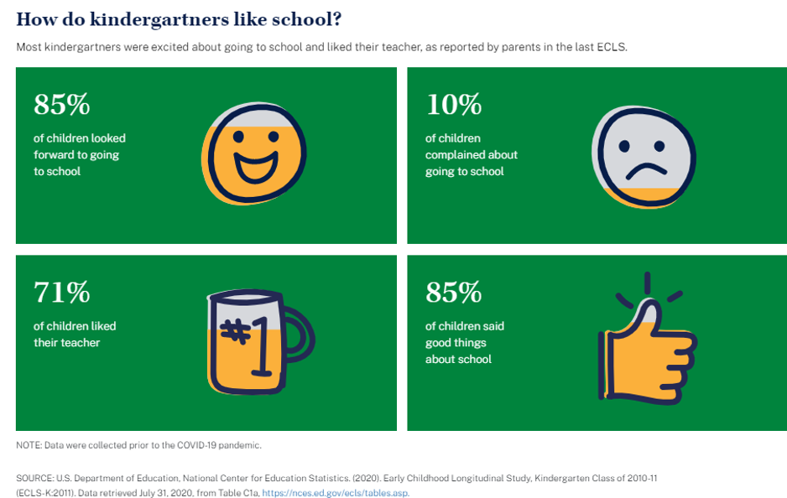
For More Information:
Contact NCES Staff
Jill Carlivati McCarroll, Study Director
  Jill.McCarroll@ed.gov
  202-304-2920
Korrie Johnson, Associate Study Director
  Korrie.Johnson@ed.gov
  202-900-8579
  nces.ed.gov/ecls/
Visit our Website
National Center for Education Statistics (NCES)

Slide 47
High School and Beyond 2022 (HS&B:22): Progress of the newest study
National Center for Education Statistics (NCES)

Slide 48
High School and Beyond Longitudinal Study of 2022 (HS&B:22) Base Year Results
Overall, the participation rate across all types of schools was under 30%
  This was the lowest school participation rate of any secondary longitudinal study since the 1970s, but not unanticipated following recent NCES experiences (e.g., MGLS:2017, PISA 2022)
Private school participation was lower than public school participation
  Catholic schools buoyed the Private school participation rate
  Good news – data were reportable by Catholic schools and Other private schools
National Center for Education Statistics (NCES)
48

Slide 49
HS&B:22 Next steps
THANK YOU – School participation would not have been achievable without your help getting out the good word and encouraging schools to take part!
Expect new data to release by summer 2024
National estimates of schools by school type – Public, Private – Catholic and Other Private
For more information visit the study’s website and contact Elise Christopher, Study Director, elise.christopher@ed.gov
National Center for Education Statistics (NCES)
49

Slide 50
NAEP 2024 Overview
National Center for Education Statistics (NCES)

Slide 51
Main NAEP Assessments
Grades 4 and 8 Mathematics and Reading
  Last administered in 2022
Grade 8 Science
  Last administered in 2019
Grade 12 Mathematics and Reading
  Last administered in 2019
National Indian Education Study (NIES) (Grades 4 and 8)
  An additional questionnaire for American Indian/Alaska Native Students
NAEP High School Transcript Study (Grade 12)
National Center for Education Statistics (NCES)

Slide 52
NAEP 2024 in Private Schools
Assessments:
  administered January 29 – March 8, 2024
  administered on Surface Pro and Chromebook devices
  possibly administered using school-provided internet
Typical student sample size up to 50 per school
  Students will only be assessed in one subject
 | Mathematics and Reading | Target # of Schools | Science | Target # of Schools | Total # of Schools
Grade 4 |  | 240 |  |  | 240
Grade 8 |  | 210 |  | 100 | 310
Grade 12 |  | 200 |  |  | 200
National Center for Education Statistics (NCES)

Slide 53
NAEP 2024 In Private Schools
In 2024, NAEP will be utilizing technology to administer the assessment online, to monitor the assessment progress remotely in real-time and allow for greater quality control.
  School Wi-Fi Mode
    Private schools will be asked if it is feasible to connect NAEP-provided devices to the school-provided internet. If yes, NAEP representatives will work with the school to obtain the information needed to connect the NAEP-provided devices.
    It is entirely optional for private schools to allow NAEP to use the school’s internet.
  NAEP Private Network Mode
    If it is not feasible to use the school’s internet, NAEP will continue to administer assessments using NAEP-provided equipment.
National Center for Education Statistics (NCES)

Slide 54




NAEP Goals for Future Assessments
With the introduction of Chromebooks in 2023, NAEP is moving towards being device agnostic, ultimately with the goal of assessing students on school-based equipment.
However, every school in the NAEP sample is important and representative of other schools of similar characteristics, and as such, needs to participate. Therefore, NAEP will provide necessary resources to ensure participation for all private schools.
National Center for Education Statistics (NCES)

Slide 55
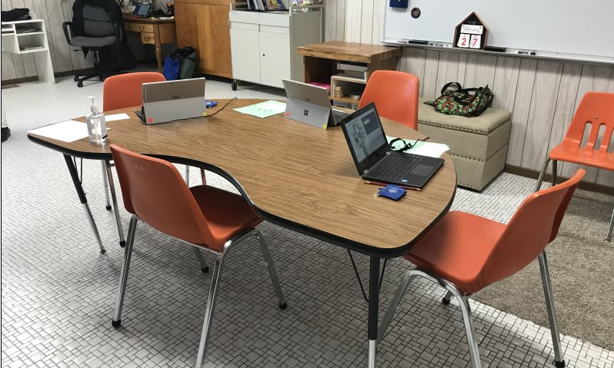
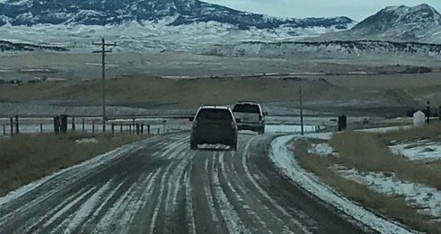
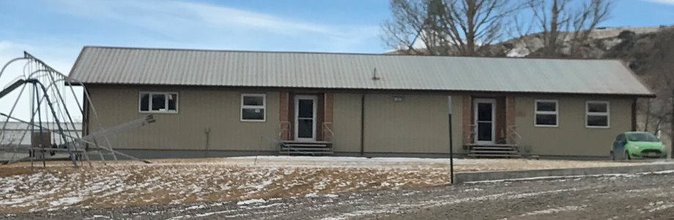
Where in the World is this School???
Hutterite colony school in Montana. The school cannot be located via GPS, so the SC met the team and they followed her for miles to the school. The school has 14 students, 3 of which were tested for NAEP at grade 8.
National Center for Education Statistics (NCES)

Slide 56
NCES Participation in International Assessments
National Center for Education Statistics (NCES)

Slide 57







International Studies Across the Lifespan
Study |  | What’s Surveyed? | Who’s Surveyed? | When?
International Early Learning Study (IELS) |  | Emerging literacy skills Emerging numeracy skills Social and emotional skills Self-regulation | 5-year-olds | 2018
Progress in International Reading Literacy Study (PIRLS) |  | Informational and literary reading literacy Online informational reading literacy | 4th-graders | 2001, 2006, 2011, 2016, 2021
Trends in International Mathematics and Science Study (TIMSS) |  | Mathematics Science | 4th-graders 8th-graders | 1995, 1999, 2003, 2007, 2011, 2015, 2019, 2023
 |  | Advanced mathematics Physics | Advanced 12th-graders | 1995, 2008, 2015
International Computer and Information Literacy Study (ICILS) |  | Computer and information literacy | 8th-graders | 2013, 2018, 2023
Program for International Student Assessment (PISA) |  | Reading literacy Mathematics literacy Science literacy Problem solving Financial literacy | 15-year-olds | 2000, 2003, 2006, 2009, 2012, 2015, 2018, 2022
Teaching and Learning International Survey (TALIS) |  | Teachers’ teaching practices, and learning environments | Teachers in grades 7, 8, and 9 | 2008, 2013, 2018, 2024
Program for the International Assessment of Adult Competencies (PIAAC) |  | Literacy skills Numeracy skills Problem solving in a technology-rich environment | Adults ages 16-65 (16-74 in the U.S.) | 2011/2012, 2022/2023
National Center for Education Statistics
National Center for Education Statistics (NCES)

Slide 58
  Examples of International Reports for Schools from the Program for International Student Assessment (PISA)
National Center for Education Statistics (NCES)

Slide 59

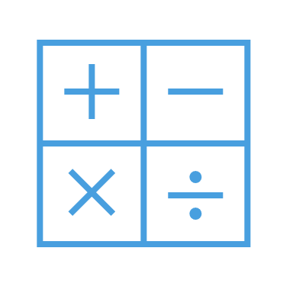

Introduction to PISA
Program for International Student Assessment
In partnership with OECD
Quick Facts
Individual School Data Options
Who’s assessed
15-year-olds
Subjects assessed
Reading literacy
Mathematics literacy
Science literacy
Problem solving
Financial literacy
How often
Every 3 years; changing to every 4 years after 2025
Next data collection
2025
Trends back to
2000
Number of participating education systems from last data collection (2022)
82
Contextual questionnaires completed by
Students, their teachers, and their principals
Contextual questionnaires selected topics
Student attitudes, dispositions, and beliefs
Home educational resources
School policies and practices
School climate and safety
OECD Test For Schools Report
(OECD)
PISA School Report
(NCES)
National Center for Education Statistics (NCES)

Slide 60
Participation in PISA 2018
Education systems
Albania | Colombia | Iceland | Malaysia | Qatar | United Kingdom
Argentina | Costa Rica | Indonesia | Malta | Romania | United States
Australia | Croatia | Ireland | Mexico | Russian Federation | Uruguay
Austria | Cyprus | Israel | Moldova, Republic of | Saudi Arabia | Vietnam
Baku-AZE | Czech Republic | Italy | Montenegro, Republic of | Serbia
Belarus | Denmark | Japan | Morocco | Singapore
Belgium | Dominican Republic | Jordan | Netherlands | Slovak Republic
Bosnia and Herzegovina | Estonia | Kazakhstan | New Zealand | Slovenia
Brazil | Finland | Korea, Republic of | North Macedonia | Spain
Brunei Darussalam | France | Kosovo | Norway | Sweden
B-S-J-Z-CHN | Georgia | Latvia | Panama | Switzerland
Bulgaria | Germany | Lebanon | Peru | Thailand
Canada | Greece | Lithuania | Philippines | Turkey
Chile | Hong Kong-CHN | Luxembourg | Poland | Ukraine
Chinese Taipei | Hungary | Macau-CHN | Portugal | United Arab Emirates
¹ B-S-J-Z-CHN refers to the four PISA participating China provinces: Beijing, Shanghai, Jiangsu, and Zhejiang.
Notes: Countries are bolded if they were OECD members as of 2018. Subnational education systems are italicized.
Source: Organization for Economic Cooperation and Development (OECD), Program for International Student Assessment (PISA).
National Center for Education Statistics (NCES)

Slide 61
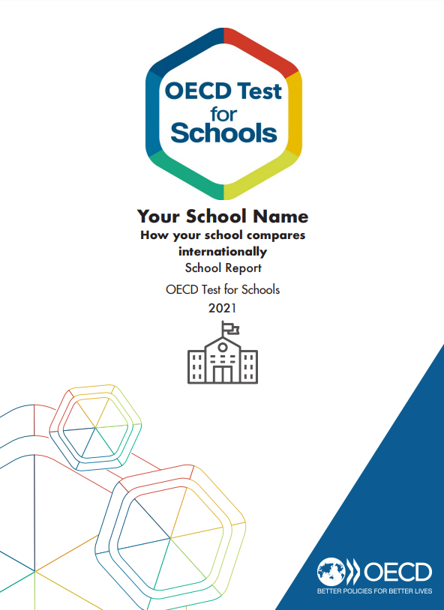
OECD Test for Schools (OECD)
The OECD Test for Schools is based on the PISA framework and delivers results that can be compared to the PISA scales
  Optional test administration for schools that would like to benchmark themselves against PISA and learn more about what their 15-year-old students know and can do in reading, mathematics, and science
  Participating schools receive a customized report that includes scores at the school level
Reports include your school’s performance compared to the United States and international averages in the areas of:
  Cognitive skills
  Student engagement and feelings
  Social and emotional skills
National Center for Education Statistics (NCES)

Slide 62
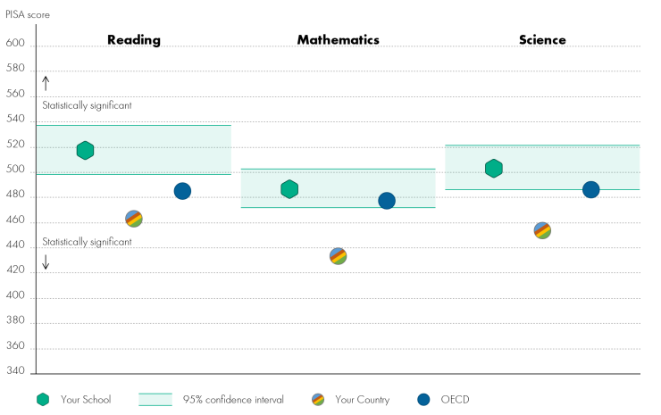
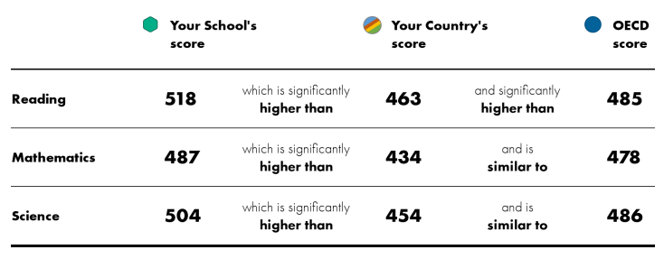
OECD Test for Schools (OECD)
Report sample: Your school’s performance compared to the U.S. average and international average across participating OECD countries
National Center for Education Statistics (NCES)

Slide 63
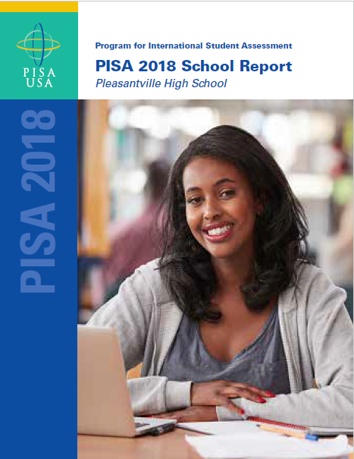
PISA School Report (NCES)
The PISA School Reports are short reports provided to PISA-participating schools, which are customized to provide a demographic and achievement profile of the participating school in relation to schools in the United States and other international education systems
Reports include information on:
  Your school’s profile
  Your school’s performance compared to the U.S. average and other U.S. schools like yours
  Your school’s performance compared to the international OECD average and participating countries
  Selected contextual highlights
  The PISA Assessment Framework
  Examples of PISA test items
National Center for Education Statistics (NCES)

Slide 64
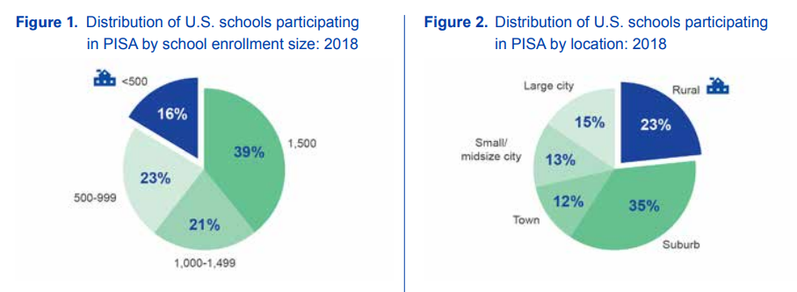
PISA School Report (NCES)
Report sample: Your school’s profile compared to other U.S. schools
National Center for Education Statistics (NCES)

Slide 65
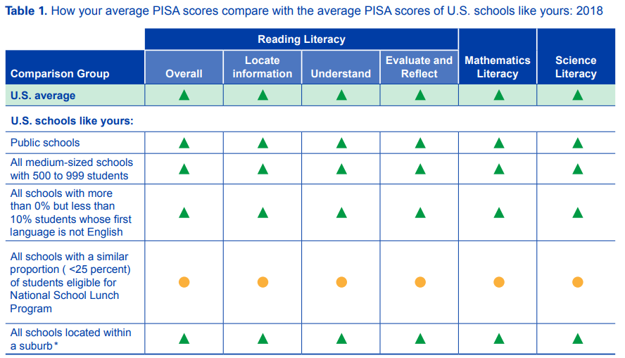

PISA School Report (NCES)
Report sample: Your school’s performance compared to the U.S. average and other U.S. schools like yours
National Center for Education Statistics (NCES)

Slide 66
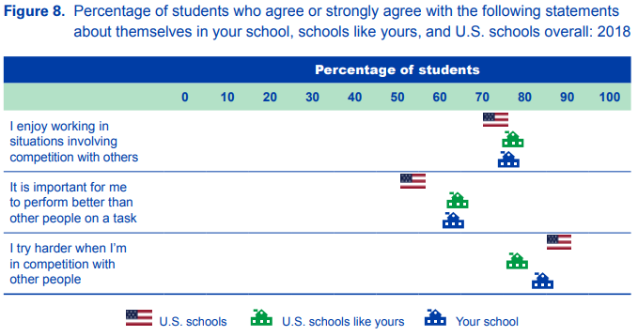
PISA School Report (NCES)
Report sample: Selected contextual highlights comparing your school to U.S. schools like yours and the U.S. average
National Center for Education Statistics (NCES)

Slide 67
  What to do your own analyses? Visit the NCES Distance Learning Data Training center for online instruction here – https://nces.ed.gov/training/datauser/#/
  If you are interested in training with NCES staff directly, please visit contacts for the studies in the slides
National Center for Education Statistics (NCES)

Slide 68
Thank You
National Center for Education Statistics (NCES)

